Slide 1

Exploratory Data Analysis
G2M Case Study
21 August 2023

Slide 2
Agenda
Executive Summary
Problem Statement
Approach
EDA
EDA Summary
Recommendations

Slide 3
XYZ, a leading US private equity firm, is seizing a golden opportunity in the surging Cab Industry. With multiple key players igniting growth, XYZ is strategically eyeing an investment.
The mission: Deliver actionable insights to pinpoint the perfect company for investment, divided into four phases:
Grasping industry trends, XYZ lays the foundation for informed choices by analyzing historical data.
XYZ employs statistical modelling to predict profitability and ride volume for different cab types, illuminating potential investment paths.
XYZ evaluates financials, operational efficiency, and market positioning to spotlight the most lucrative cab company amidst competition.
Culminating the analysis, XYZ offers well-informed investment advice, guiding their journey in the dynamic cab landscape.
Project Background

Slide 4
Considerations:
While identifying potential outliers in the 'Price_Charged' feature, we acknowledge that the absence of trip duration details limits our ability to conclusively label these observations as outliers.
The computation of ride profits is based solely on the 'Price_Charged' and 'Cost_of_Trip' features, holding all other factors constant. This approach offers a simplified insight into profitability while recognizing the multifaceted nature of ride economics.
Data Exploration
Cab_Data.csv
Customer_ID.csv
Transaction_ID.csv
City.csv
USholiday.csv
Final Cab Data

Slide 5
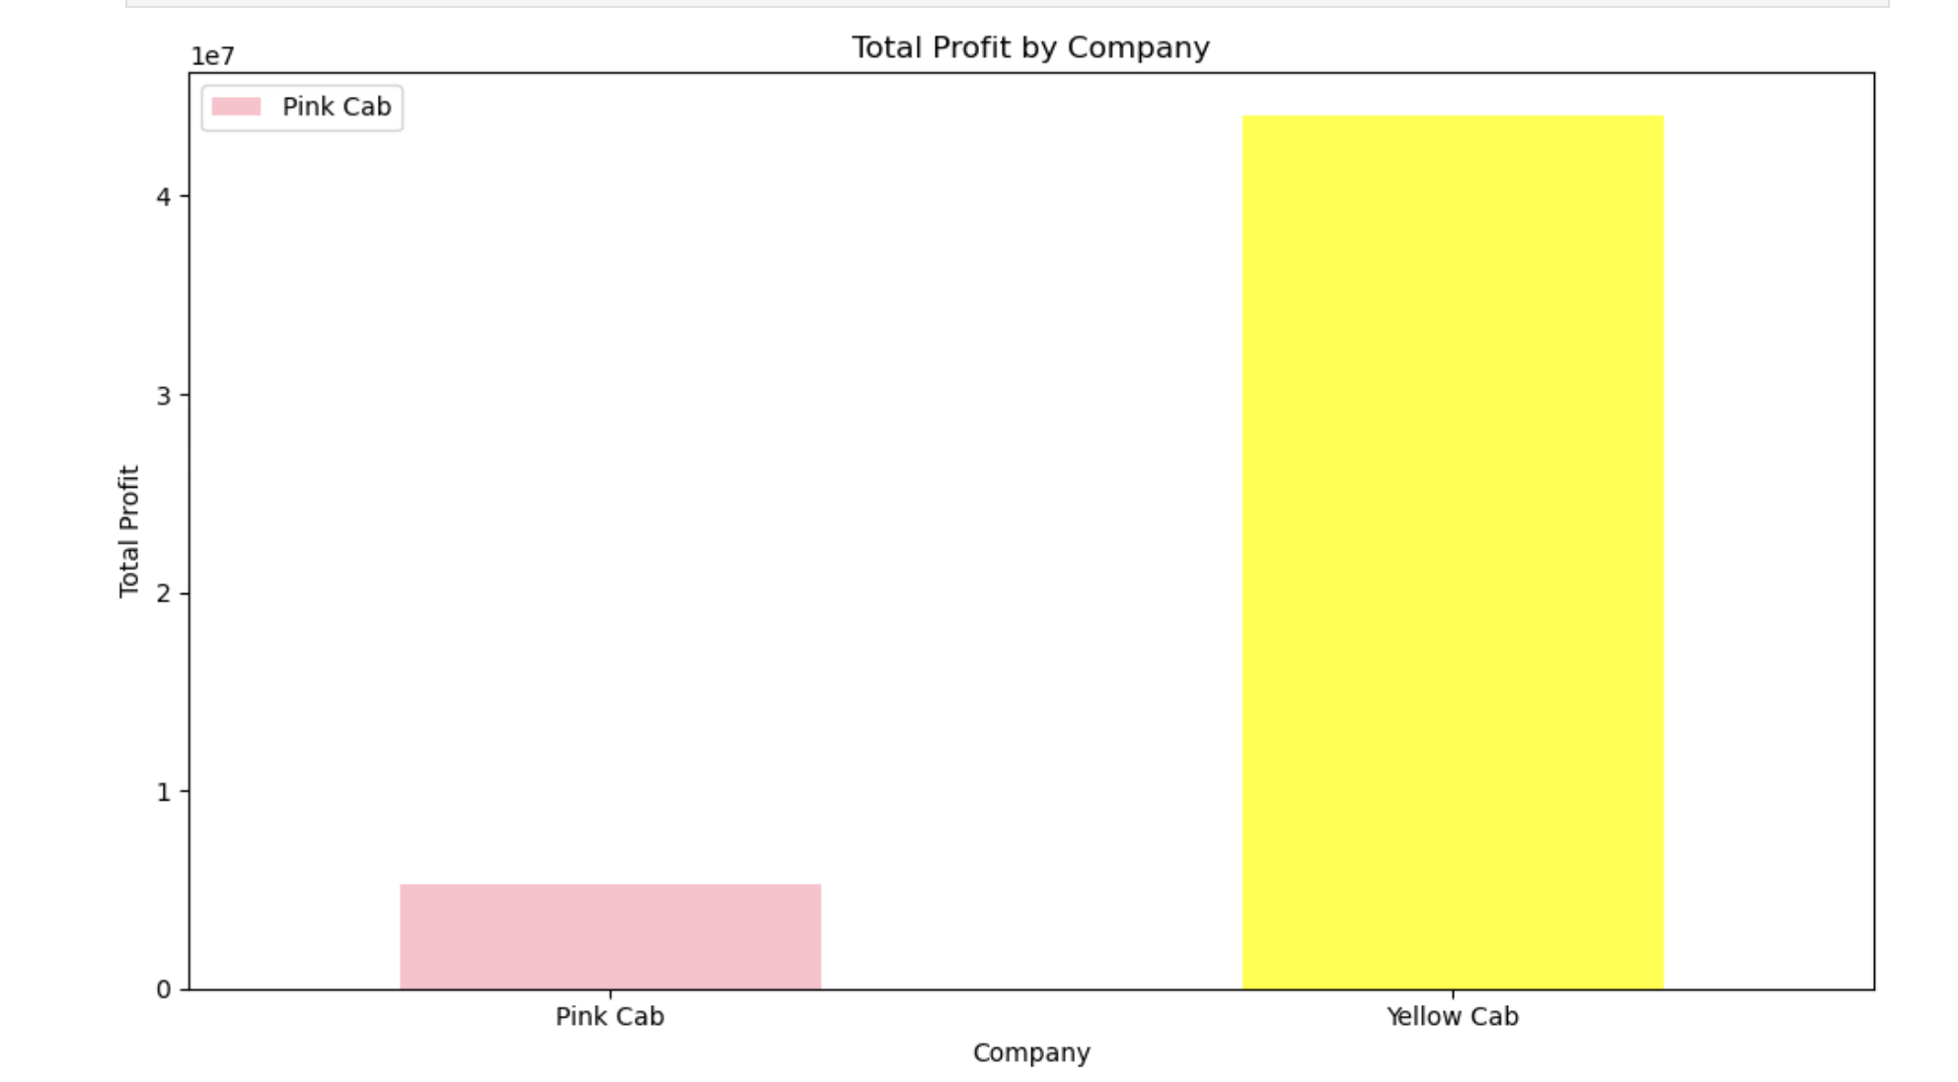
During the years 2016-2018, the financial performance of Yellow Cab clearly outshines that of Pink Cab. Yellow Cab has demonstrated consistently higher levels of profitability, reinforcing its position as the more lucrative option in the cab industry. Across this three-year period, Yellow Cab has showcased superior profit margins and maintained a substantial lead over Pink Cab in terms of overall profitability. This compelling performance underscores the financial prowess and competitive edge of Yellow Cab in comparison to Pink Cab.
Profit Analysis

Slide 6
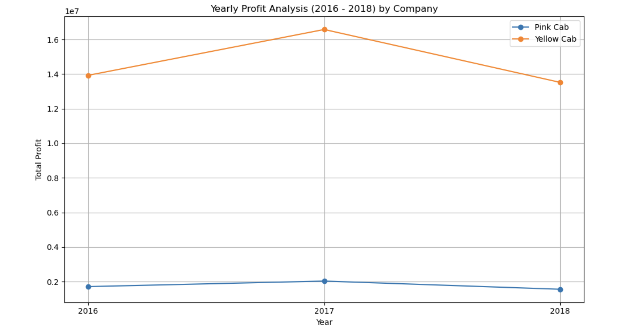
The annual profit analysis of the Pink Cab reveals consistent revenue patterns, reflecting stability over the years. On the other hand, the Yellow Cab demonstrates a noteworthy increase in revenue, particularly evident during the year 2017.
Profit Analysis

Slide 7
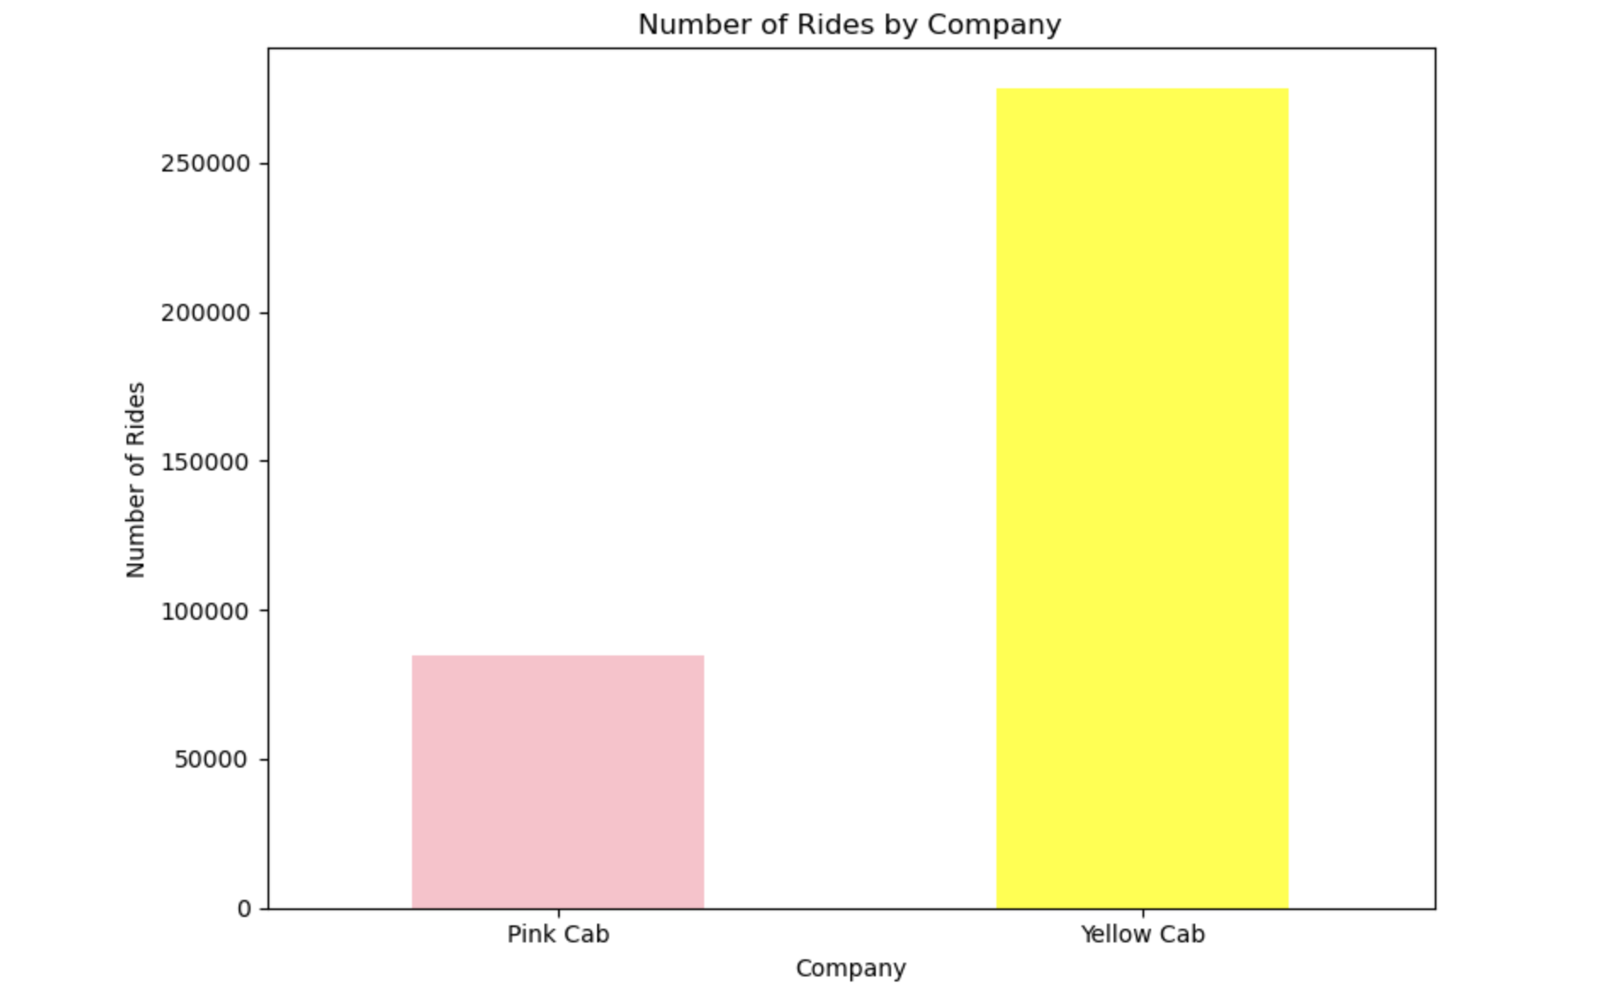
Throughout the years 2016 to 2018, the Yellow Cab has demonstrated a consistently higher volume of rides when compared to the Pink Cab. The data clearly illustrates that the Yellow Cab has maintained a substantial lead in the number of rides, reaffirming its dominant position within the market during this three-year period. Evidently, there exists a higher demand for Yellow Cab services in comparison to Pink Cab.
Market Analysis

Slide 8
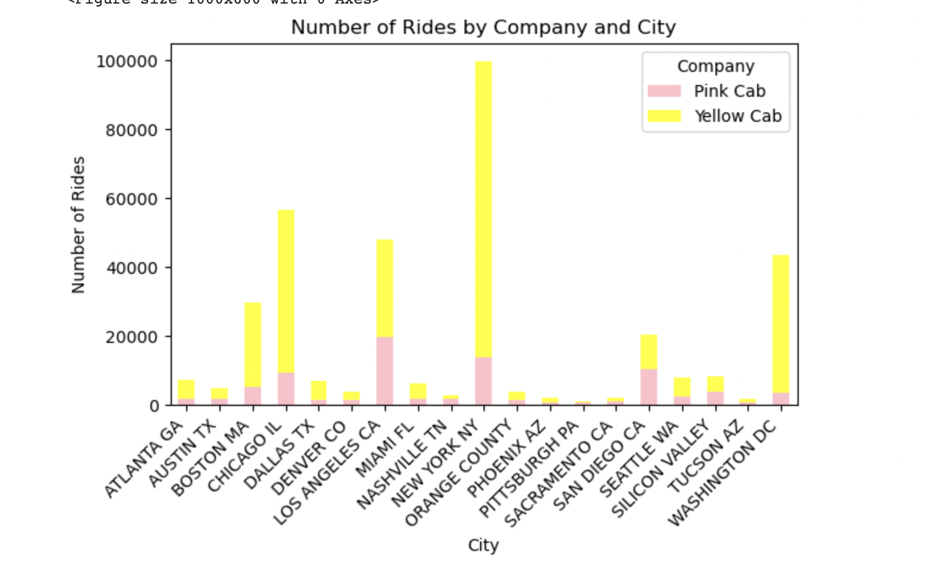
The Yellow Cab has established a substantial presence in prominent urban centres such as Chicago, Washington, and New York, reflecting a significant foothold in these key markets.
Market Analysis

Slide 9
Based on the insights derived from the data analysis, there are several compelling reasons to consider investing in the Yellow Cab:
1. Higher Demand and Market Share: The Yellow Cab has consistently demonstrated a stronger demand and higher number of rides compared to the Pink Cab. This suggests that the Yellow Cab has a more established and widespread customer base, indicating a potential for greater market share.
2. Profitability Potential: The data reveals that the Yellow Cab has exhibited higher revenue and profitability, especially during certain years like 2017. This indicates a strong ability to generate profits, which is a crucial factor for any investment decision.
3. Key Urban Markets: The Yellow Cab has established itself as a dominant player in major cities such as Chicago, Washington, and New York. Investing in the Yellow Cab could provide access to these thriving urban markets with existing customer recognition and brand loyalty.
4. Revenue Growth: The observed revenue increase in specific years, such as 2017, demonstrates the Yellow Cab's potential to adapt to changing market dynamics and capitalize on opportunities for growth.
5. Rider Preference: The higher demand for the Yellow Cab suggests that customers have a preference for this service. Understanding customer preferences and aligning investment decisions accordingly can contribute to long-term success.
6. Market Resilience: Despite potential challenges, Yellow Cab has maintained its position and profitability over the analysed years. This resilience indicates that it can withstand market fluctuations and continue to deliver returns.
7. Operational Efficiency: The Yellow Cab's consistent profitability could imply efficient operations and cost management strategies, further enhancing the potential for sustainable growth.
In conclusion, the data-driven insights suggest that investing in the Yellow Cab could be a strategic move due to its higher demand, revenue potential, and well-established presence in key markets.
Recommendation

Slide 10
-
Thank You

